Slide 1
Utility Network SDK
Alpha 10 Overview
September 7, 2016

Slide 2
Overview
This document provides an overview of the utility network SDK
SDK Sections:
Core
Definition
Network Topology
Tracing
Diagrams

Slide 3
Core
UtilityNetwork and FeatureElement

Slide 4
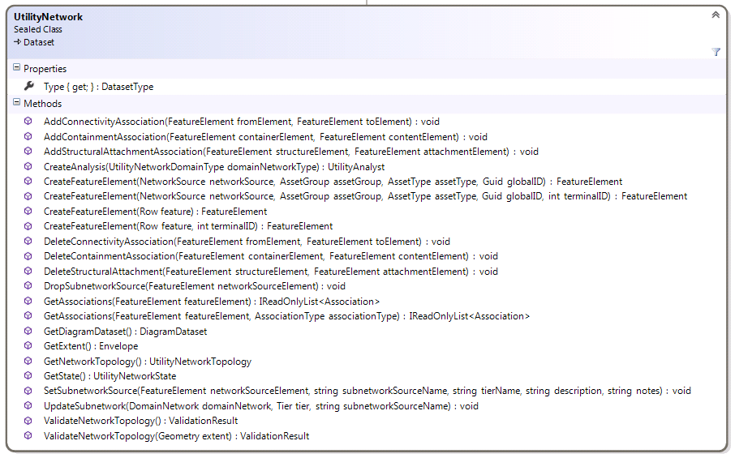
UtilityNetwork
The UtilityNetwork class serves as the core class in the utility network SDK
It is obtained using Geodatabase.OpenDataset<UtilityNetwork>
Use the UtilityNetwork class to:
Create and delete associations
Update subnetworks
Update and query network topology
Get other utility network classes

Slide 6
UtilityNetwork: Create and Delete Associations
AddConnectivityAssociation(FeatureElement fromElement, FeatureElement toElement) : void
AddContainmentAssociation(FeatureElement containerElement, FeatureElement contentElement) : void
AddStructuralAttachmentAssociation(FeatureElement structureElement, FeatureElement attachmentElement) : void
DeleteConnectivityAssociation(FeatureElement fromElement, FeatureElement toElement) : void
DeleteContainmentAssociation(FeatureElement containerElement, FeatureElement contentElement) : void
DeleteStructuralAttachmentAssociation(FeatureElement structureElement, FeatureElement attachmentElement) : void
These routines add and delete associations using the FeatureElement class
These routines create dirty areas; they do not update network topology
Calls to these routines must be wrapped in a transaction
Called from Geodatabase.ApplyEdits()

Slide 7
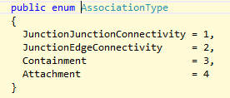
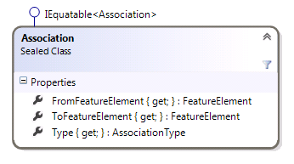
Get Associations
GetAssociations(FeatureElement featureElement, AssociationType type) : IReadOnlyList<Association>
GetAssociations(FeatureElement featureElement) : IReadOnlyList<Association>
AssociationType is defined as follows:
If the AssociationType parameter is missing, associations of all types are returned
The Association return type is defined as follows:

Slide 8
More Information about GetAssociations
GetAssociations returns the contents of the internal associations table.
The routine does not return an accurate or complete picture of connectivity; features that are connected by geometric coincidence are not returned.
The list returned can contain associations that have not yet been validated and are therefore not yet included in the topological index.
Conversely, it will not return deleted records that still exist in the topological index

Slide 9
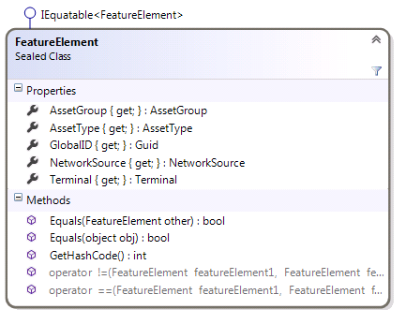
FeatureElement Class
This class represents a Feature inside a utility network, plus a Terminal
FeatureElements can be created using factory methods on UtilityNetwork
CreateFeatureElement(NetworkSource networkSource, Subtype assetGroup, AssetType assetType, Guid globalD, int terminalID) : FeatureElement
CreateFeatureElement(NetworkSource networkSource, Subtype assetGroup, AssetType assetType, Guid gloalID) : FeatureElement
CreateFeatureElement(Row row, int terminalID) : FeatureElement
CreateFeatureElement(Row row) : FeatureElement
FeatureElements can also be obtained from the network topology using UtilityNetworkTopology.GetFeatureElement()
Read-only Properties
NetworkSource : NetworkSource
AssetGroup : AssetGroup
AssetType : AssetType
GlobalID : Guid
Terminal : Terminal

Slide 10
UtilityNetwork: Subnetworks
SetSubnetworkSource(FeatureElement networkSourceElement, string subnetworkSourceName, string tierName, string description, string notes) : void
DropSubnetworkSource(FeatureElement networkSourceElement) : void
These routines add and remove subnetwork sources from the network
These routines create dirty areas; they do not update the network index
Calls to these routines must be wrapped in a transaction
Called from Geodatabase.ApplyEdits()
UpdateSubnetwork(DomainNetwork domainNetwork, Tier tier, string subnetworkSourceName) : void
Updates the given subnetwork. This is the equivalent of running the Update Subnetwork geoprocessing tool on the specified subnetwork.
More Subnetwork routines will be added to the SDK in a future alpha release.

Slide 11
UtilityNetwork: Validate Network Topology
ValidateNetworkTopology(Geometry extent) : NetworkTopologyValidationResult
ValidateNetworkTopology() : NetworkTopologyValidationResult
Updates network topology within the provided extent. If the extent parameter is missing or null, the extent of the utility network is used.
Calls to this routine must be wrapped in a transaction
Called from Geodatabase.ApplyEdits()

Slide 12
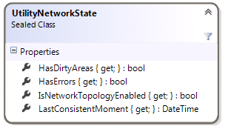
UtilityNetwork: Network Topology Queries
GetExtent() : Envelope
Returns the extent of the feature classes within the network (same as other controller datasets in the product)
GetState() : UtilityNetworkState
Returns the state of the network

Slide 13
UtilityNetwork: Get Other Utility Network Classes
The UtilityNetwork object also serves a central access point to several other utility network classes
CreateAnalysis(UtilityNetworkDomainType domainNetworkType) : UtilityAnalyst
Covered in the Analysis section of this document
GetDefinition() : UtilityNetworkDefinition
Covered in the Definition section of this document
GetDiagramDataset() : DiagramDataset
Covered in the Diagrams section of this document
GetNetworkTopology() : UtilityNetworkTopology
Covered in the Network Topology section of this document

Slide 14
Definition
UtilityNetworkDefinition and friends

Slide 15
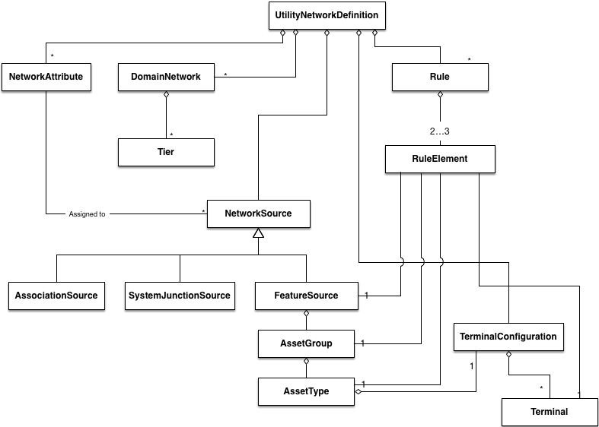

Slide 17
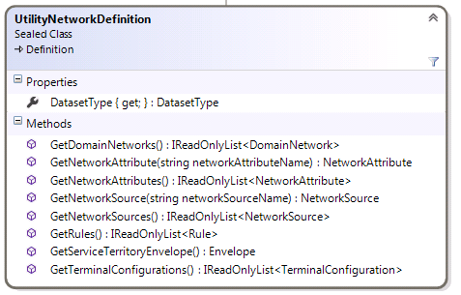
UtilityNetworkDefinition
The UtilityNetworkDefinition class provides information about a utility network.
This includes information about domain networks, network sources, association rules, terminals, and network attributes
The UtilityNetworkDefinition object is obtained through a call to UtilityNetwork.GetDefinition()

Slide 18
UtilityNetworkDefinition: General Routines
DatasetType : DatasetType
Returns the dataset type.
This is identical to the value returned by UtilityNetwork.Type. Both properties are included to conform with the convention established by other dataset types
GetServiceTerritoryEnvelope() : Envelope
Returns the extent of the utility network (i.e., the extent of the service territory + 10%).
Note that this can be slightly different than the value returned by UtilityNetwork.GetExtent()

Slide 20
UtilityNetworkDefinition: Domain Networks
A domain network represents an industry domain
Some examples include electric distribution, electric transmission, gas, and water
UtilityNetworkDefinition.GetDomainNetworks() : IReadOnlyList<DomainNetwork>
Returns a list of domain networks included with this utility network

Slide 21
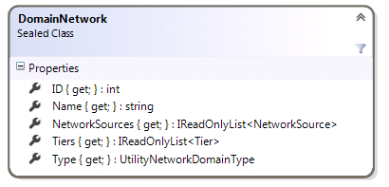
Domain Network
ID : int
An identifier for the domain network. This identifier is unique within a single utility network
Name : string
A user-readable string
Type : UtilityNetworkDomainType
The type of this domain network (Custom, Structure, ElectricDistribution, ElectricTransmission, Gas, WaterDistribution, WaterTransmission, CathodicProtection)
This routine will be removed in a future alpha. Currently it always returns Custom.
NetworkSources : IReadOnlyList<NetworkSource>
The list of network sources for this domain network. Network sources are described later in this document
Tiers : IReadOnlyList<Tier>
Returns the tiers in this domain network. Tiers are described later in this document

Slide 23
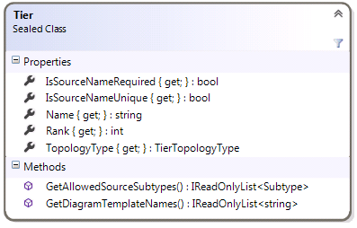
Tiers - 1
Tiers demarcate a logical level within the network
E.g., in an electric distribution network, there may be Subtransmission, MediumVoltage, and LowVoltage tiers
Some networks may only have one tier, such as electric transmission
Tiers are value objects
IsSourceNameRequired : bool
Determines whether subnetwork sources within this tier require a name
IsSourceNameUnique : bool
Determines whether subnetwork sources within this tier require unique names
GetAllowedSourceSubtypes() : IReadOnlyList<Subtype>
Returns a list of subtypes that can be subnetwork sources within this tier
This routine will be changed in a future alpha release

Slide 24
Tiers - 2
GetDiagramTemplateNames() : IReadOnlyList<string>
Returns the default diagram templates for this tier
Name : string
The name of the tier (e.g., “Medium voltage”)
Rank : int
The numeric rank of the tier.
TopologyType : TierTopologyType
The type of subnetworks that are supported
TierTopologyType is an enum with the values Radial, MultifeedRadial and Mesh

Slide 26
Network Sources
A Network Source is a feature class that can serve as sources of information for a utility network . It should not be confused with a subnetwork source.
Network Sources can be obtained with four different routines:
UtilityNetworkDefinition.GetNetworkSource(string networkSourceName) : NetworkSource
UtilityNetworkDefinition.GetNetworkSources() : IReadOnlyList<NetworkSource>
DomainNetwork.NetworkSources : IReadOnlyList<NetworkSource>

Slide 27
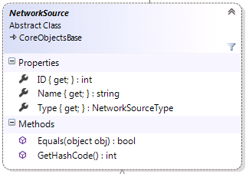
NetworkSource
NetworkSource is the abstract base class for the Network Source class family
ID : int
The numeric ID of the network source
Name : string
The name of the network source. This is the name of the underlying table, not a user-readable name.
Type : NetworkSourceType
The values for the NetworkSourceType enum are as follows: SystemJunction, Boundary, Junction, Edge, Association
NetworkSource objects can be compared with the comparison operator

Slide 28
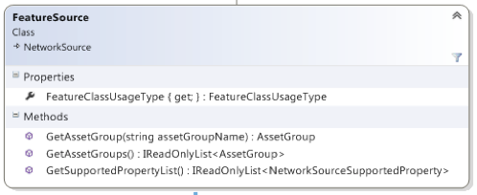
FeatureSource
FeatureSource represents a source that is created from a user feature class
FeatureClassUsageType : FeatureClassUsageType
This property returns how the feature class is used.
Possible values are Device, Junction, Line, Assembly, SubnetLine, StructureJunction, StructureLine, and StructureBoundary.
GetAssetGroup(string assetGroupName) : AssetGroup
GetAssetGroups() : IReadOnlyList<AssetGroup>
Returns one or more AssetGroups (subtypes) for this particular feature class
GetSupportedPropertyList() : IReadOnlyList<NetworkSourceSupportedProperty>
Returns the properties that this network source supports. Possible values are Containment, StructuralAttachments, Categories, Terminals, NetworkAttributes.

Slide 29
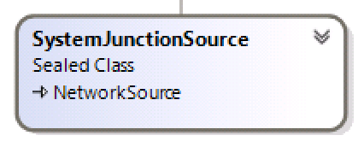
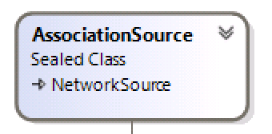
System Sources
SystemJunctionSource
Concrete class that represents system junctions (marker interface)
AssociationSource
Concrete class that represents associations (marker interface)

Slide 31
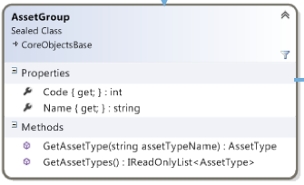
AssetGroup
The AssetGroup class provides information about Asset Groups (subtypes) within the utility network. In the core geodatabase, they are implemented as subtypes.
Code : int
The subtype code
Name : string
The subtype name
GetAssetType(string assetTypeName) : AssetType
GetAssetTypes() : IReadOnlyList<AssetType>
Returns Asset Type definitions

Slide 33
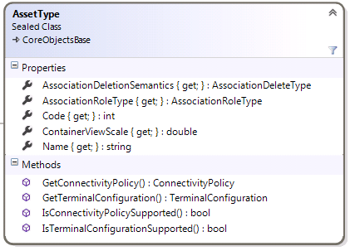
AssetType - 1
Provides information about the definition of an AssetType
Code : int
The code of the AssetType domain
Name: string
The string value of the AssetType domain
IsConnectivityPolicySupported() : bool
Returns whether or not the GetConnectivityPolicy() routine is applicable.
GetConnectivityPolicy() : ConnectivityPolicy
Returns whether connectivity for this asset type can be established at any vertex (AnyVertex) or only at end points (EndVertex)
AssocationDeletionSemantics : AssociationDeleteType
The deletion type for this asset class (Cascade, None, Restricted)

Slide 34
AssetType - 2
ContainerViewScale : double
Returns the default scale of any containers created from this asset type.
If the asset type is not a container, this routine returns 0.0.
AssociationRoleType : AssociationRoleType
Returns whether the asset type can be a Container, Structure, or neither (None).
GetCategoryList() : IReadOnlyList<string>
Returns the categories supported
IsTerminalConfigurationSupported() : bool
Returns whether or not the GetTerminalConfiguration() routine is applicable
GetTerminalConfiguration() : TerminalConfiguration
Returns the TerminalConfiguration for this asset type

Slide 35
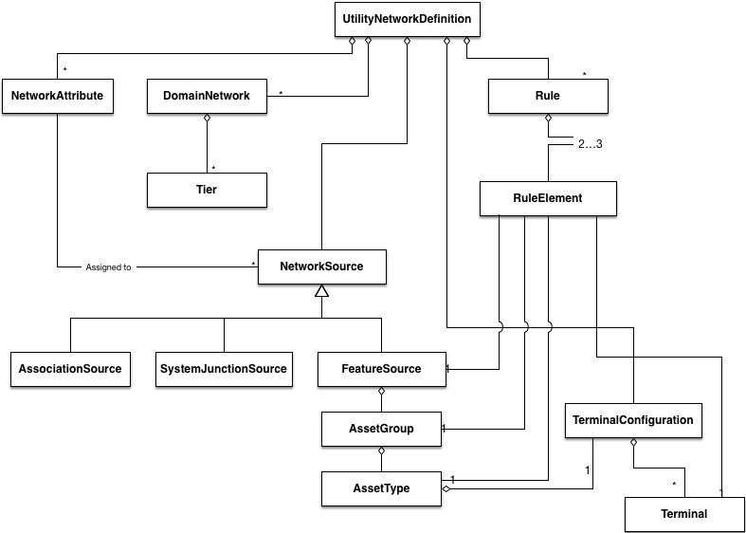

Slide 36
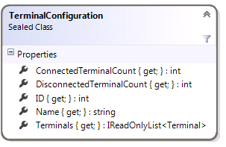
Terminal Configurations
This class will be redesigned in a future alpha release
Terminal configurations are immutable value objects that represent a configuration of terminals associated with 0 or more subtypes.
Terminal configurations can be obtained through two different methods:
UtilityNetworkDefinition.GetTerminalConfigurations() : IReadOnlyList<TerminalConfiguration>
JunctionSource.GetTerminalConfiguration(Subtype subtype) : TerminalConfiguration
ConnectedTerminalCount : int
DisconnectedTerminalCount : int
ID : int
Name : string
A user-readable string that describes the terminal configuration
Terminals : IReadOnlyList<Terminal>

Slide 37
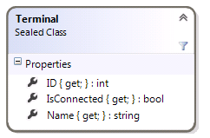
Terminals
This class will be redesigned in a future alpha release
Terminal is an immutable value object representing a single terminal on a junction feature
ID : int
IsConnected : bool
Name : string
A user-readable string

Slide 39
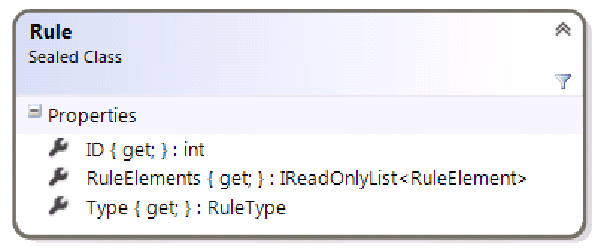
Rule
Describes a rule in the utility network. These define how features in a utility network can be associated with each other through connectivity, containment, and attachment
Rule objects are obtained by calling UtilityNetworkDefinition.GetRules() : IReadOnlyList<Rule>
Type : RuleType
Returns either JunctionJunctionConnectivity, JunctionEdgeConnectivity, Containment, Attachment, or EdgeJunctionEdgeConnectivity telling us what kind of rule it is
ID : int
Returns a numeric ID that can be used to identify the rule
RuleElements : IReadOnlyList<RuleElement>
The elements that make up the rule (see next slide)

Slide 40
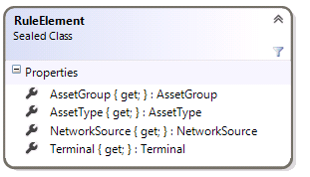
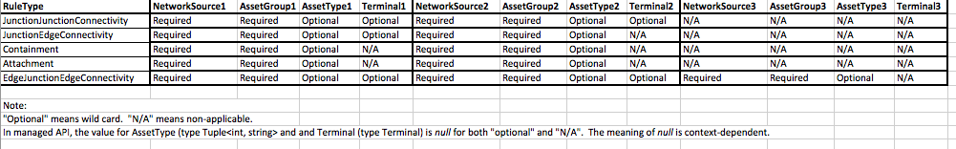
RuleElements
This is a value class that stores information about the elements of a rule.
NetworkSource : NetworkSource
AssetGroup : AssetGroup
AssetType : AssetType
Terminal : Terminal
The meaning of these parameters depend on the rule type, as illustrated below:

Slide 42
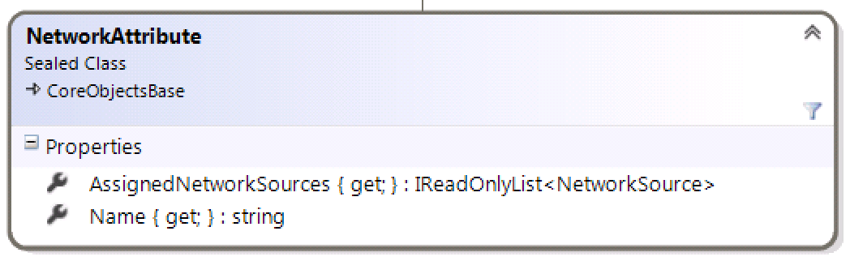
Network Attributes
The NetworkAttribute class represents a network attribute (or weight)
NetworkAttributes can be obtained by calling UtilityNetworkDefinition.GetNetworkAttributes() : IReadOnlyList<NetworkAttribute>
UtilityNetworkDefinition.GetNetworkAttribute(string networkAttributeName): NetworkAttribute
AssignedNetworkSources : IReadOnlyList<NetworkSource>
Name : string
DataType : NetworkAttributeDataType
The usage of Network Attribute objects is discussed in the section on Network Topology

Slide 43
Definition Classes and Services
I don’t see any problem supporting these classes with services
I would expect definition information to be cached client-side as needed

Slide 44

Network Topology
UtilityNetworkTopology, NetworkElement, NetworkAttribute, NetworkEvaluator, and friends

Slide 45
Important Note about this Section
We are currently evaluating how these routines will work in a services-only environment.
Future versions of the utility network alpha could present a coarser-grained API than the one shown here.
In particular, the API may become more feature-focused rather than network element-focused

Slide 46
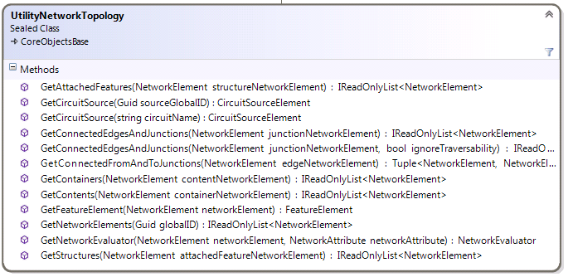
UtilityNetworkTopology
The UtilityNetworkTopology class provides low-level query capabilities against network topology.
The UtilityNetworkTopology object is obtained through a call to UtilityNetwork.GetNetworkTopology().

Slide 47
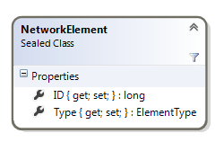
NetworkElement
Utility network topology deals with individual edges and junctions as NetworkElement objects
A single feature can be composed of multiple NetworkElements
Example 1: A MediumVoltage line can consist of multiple edge elements
Example 2: A CircuitBreaker device consists of two junction elements representing the terminals, plus an internal edge in between them
NetworkElement objects are obtained from methods on the UtilityNetworkTopology class
The NetworkElement class implements IEquatable<T>
ID : long
A unique identifier
Type : ElementType
Describes the type of network element. Valid values are None, Junction, or Edge.

Slide 48
UtilityNetworkTopology – Converting Between FeatureElements and NetworkElements
GetFeatureElement(NetworkElement networkElement) : FeatureElement
Returns the FeatureElement corresponding to a given NetworkElement
Terminal of the FeatureElement is null for edge features and junction features without terminals; otherwise the correct Terminal object is returned
GetNetworkElements(Guid globalID) : IReadOnlyList<NetworkElement>
Returns the list of NetworkElements that compose the feature identified by the globalID parameter
Note that there is no routine to convert between a FeatureElement and a NetworkElement
But it’s not rocket science…
IReadOnlyList<NetworkElement> networkElements = networkTopology.GetNetworkElements(featureElement.GlobalID);

Slide 49
UtilityNetworkTopology – Connectivity
GetConnectedEdgesAndJunctions(NetworkElement junctionNetworkElement) : IReadOnlyList<NetworkElement>
Returns the NetworkElements connected to a junction.
GetConnectedFromAndToJunctions(NetworkElement edgeNetworkElement) : Tuple<NetworkElement, NetworkElement>
Returns the NetworkElements connected to an edge

Slide 50
UtilityNetworkTopology – Containment
GetContainers(NetworkElement contentNetworkElement) : IReadOnlyList<NetworkElement>
Returns the containers that contain the contentNetworkElement
Note that if contentNetworkElement is an edge, it could belong to multiple containers
GetContents(NetworkElement containerNetworkElement) : IReadOnlyList<NetworkElement>
Returns the contents of the container represented by the containerNetworkElement

Slide 51
UtilityNetworkTopology – Structural Attachments
GetAttachedFeatures(NetworkElement structureNetworkElement) : IReadOnlyList<NetworkElement>
Returns a list of network elements attached the the given structureNetworkElement structure
GetStructures(NetworkElement attachedFeatureNetworkElement) : IReadOnlyList<NetworkElement>
Returns the structure that the given attachedFeatureNetworkElement is attached to

Slide 52
UtilityNetworkTopology - CircuitSources
GetCircuitSource(Guid sourceGlobalID) : CircuitSourceElement
GetCircuitSource(string circuitName) : CircuitSourceElement
These routines, as well as the CircuitSourceElement class, are slated for replacement in a future utility network alpha release.

Slide 53
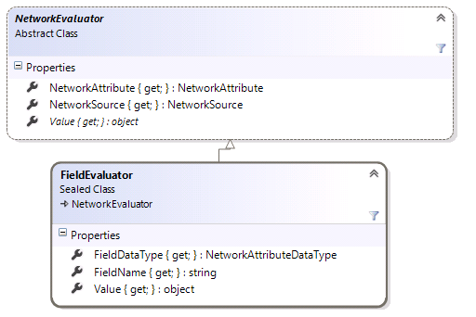
Network Evaluators
Network evaluators are used to provide the value of a network attribute for a given network element
Network evaluators are obtained by calling UtilityNetwork.GetNetwork
GetNetworkEvaluator(NetworkElement networkElement, NetworkAttribute networkAttribute) : NetworkEvaluator

Slide 54
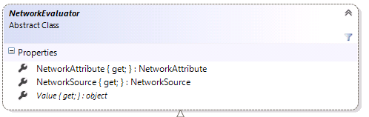
NetworkEvaluator
NetworkAttribute : NetworkAttribute
The NetworkAttribute that the evaluator used to compute its value
NetworkSource : NetworkSource
The NetworkSource used by this evalutor
Value : object
The value of the network attribute for the network element used to construct the evaluator

Slide 55
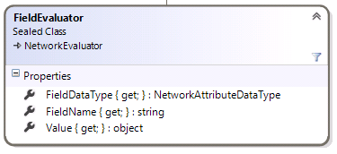
FieldEvaluator
The FieldEvaluator adds two properties to the abstract base class.
FieldDataType : NetworkAttributeDataType
The data type of the field that provides values for the network attribute
FieldName : string
The name of the field that provides values for the network attribute

Slide 56
Tracing

Slide 57
Tracing Not Available in Alpha 10
During Alpha 10, we made significant changes to the internal implementation of tracing
Tracing is now built on an extensible framework, and not hard-wired to any Esri data models
These changes are not yet reflected in the C# SDK
Existing tracing routines have been disabled
Possible workarounds for Alpha 10
Run tracing using the user interface
Execute tracing geoprocessing tools from C# using Python
Providing a new and improved tracing SDK is a high priority for Alpha 11

